Slide 1
Hello Word program
Python ev3dev

Slide 2
Write the first program in EV3
Before going on, please make sure that you updated the kernel and everything on Lesson 1. Make sure that you have the dis2unix package.

Slide 3
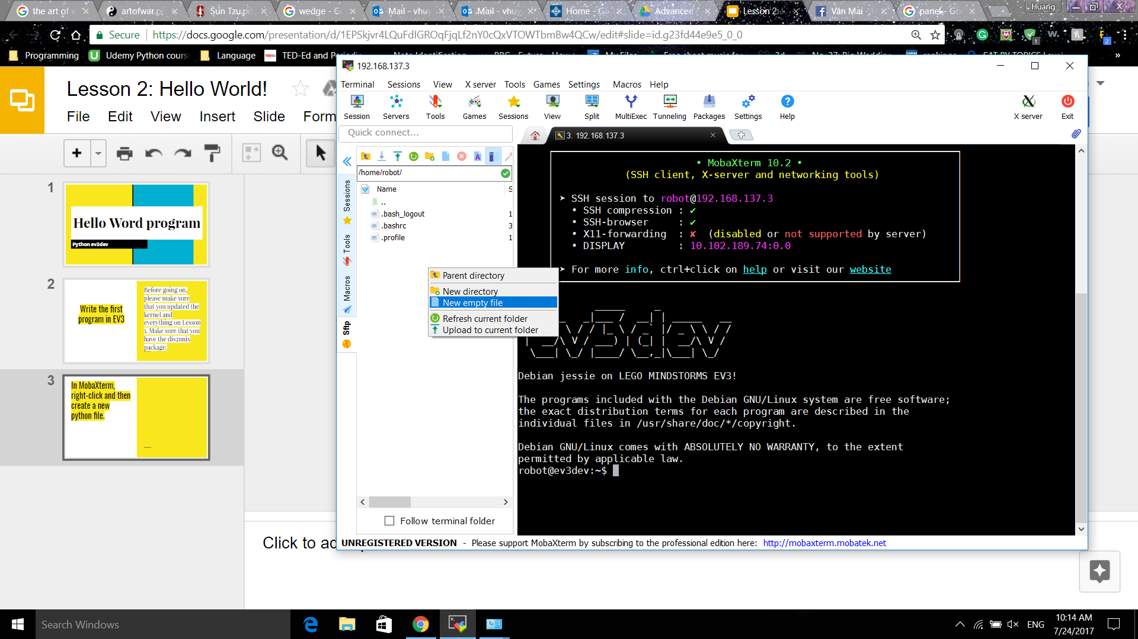
In MobaXterm, right-click and then create a new python file.

Slide 4
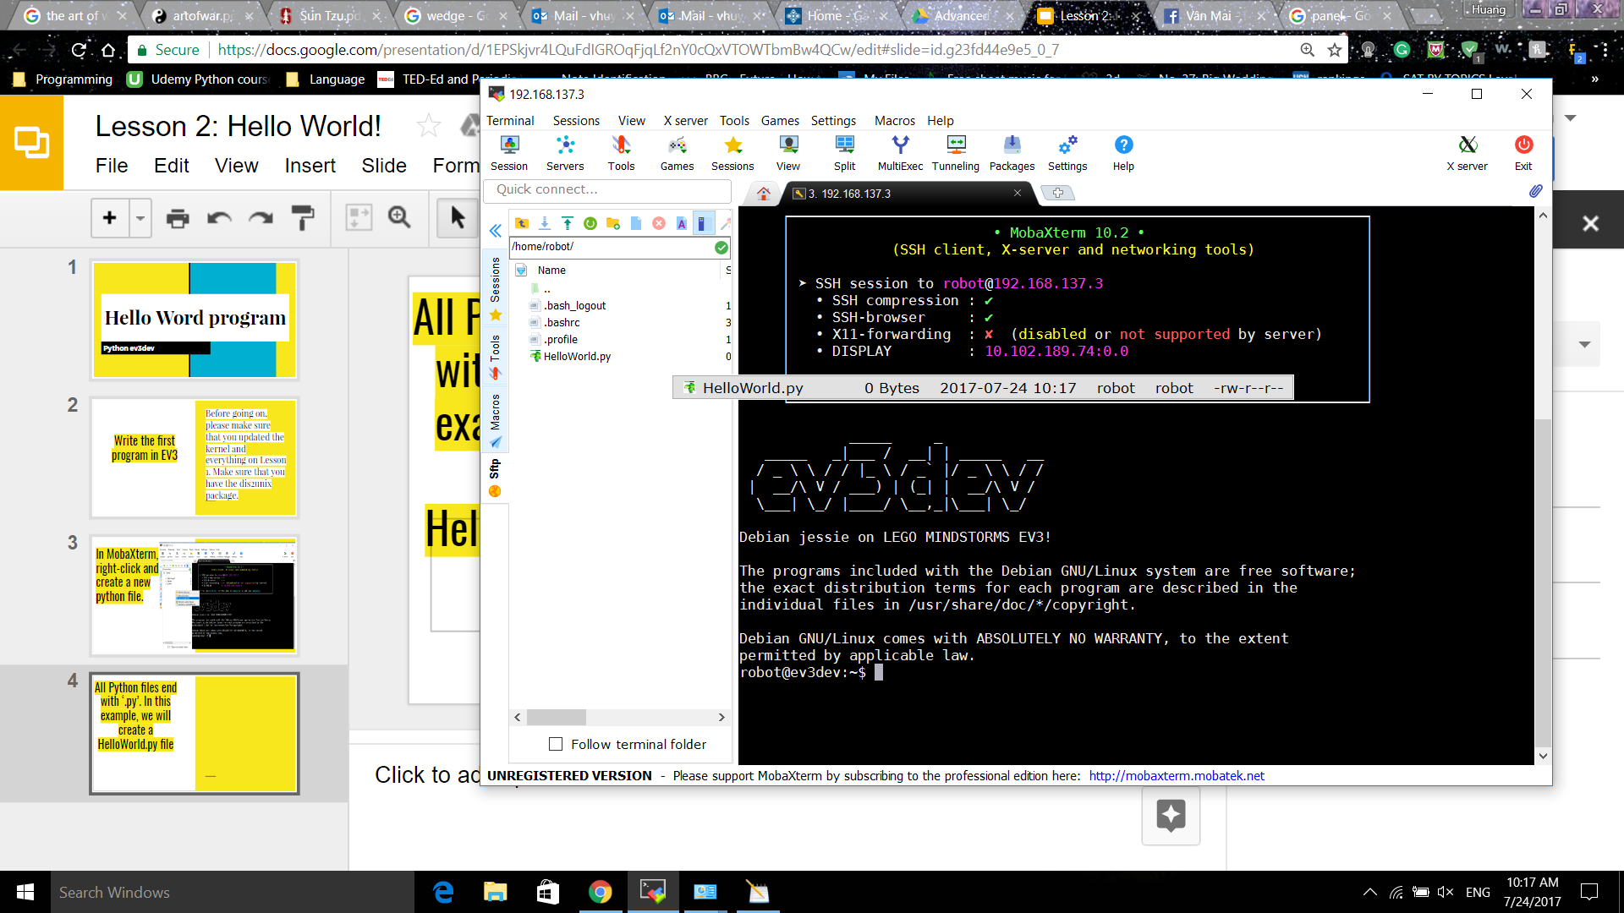
All Python files end with ‘.py’. In this example, we will create a HelloWorld.py file

Slide 5
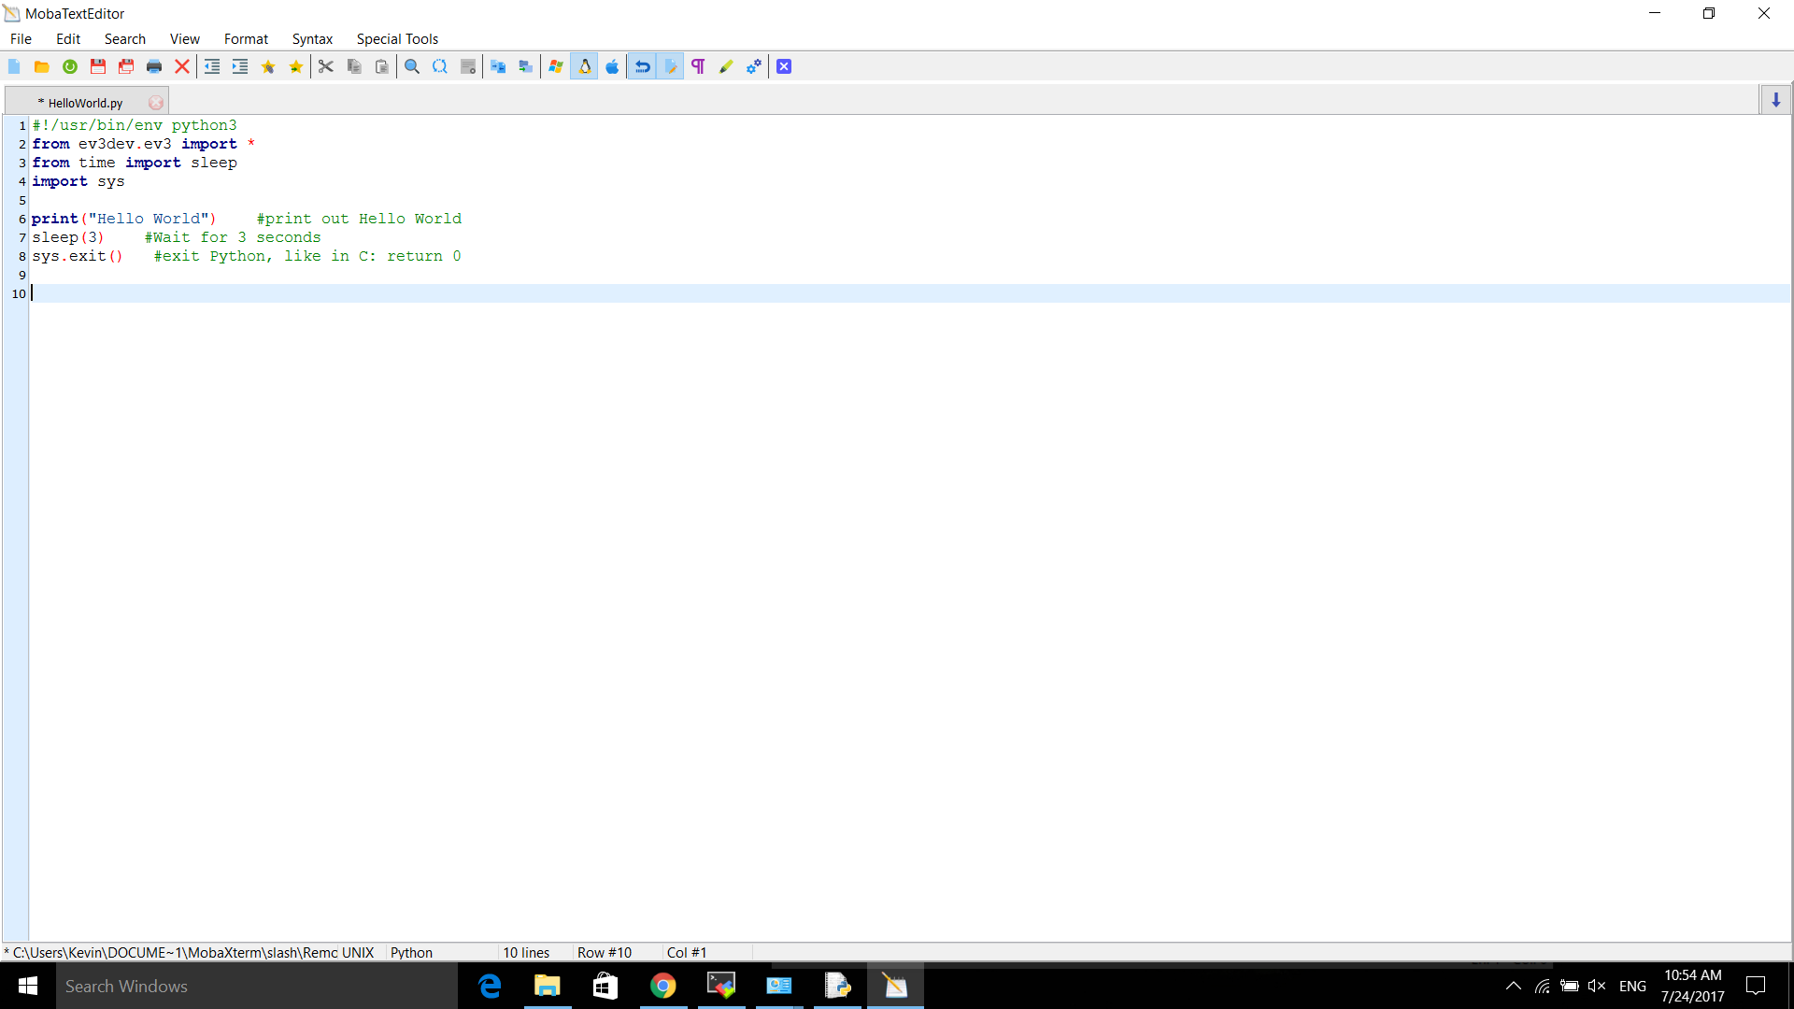
The first 3 lines are very important at the beginning and must be kept in all other programs
The asterisk * indicates that the program has not been saved. Press Ctrl+S to save the program

Slide 6
‘#! /usr/bin/env python 3’ is a shebang and MUST BE included in THE FIRST LINE. In Python, the commands after hashtag # will be seen as comments, but NOT IN THIS CASE.

Slide 7
‘from ev3dev.ev3 import *’ imports all packages from ev3dev to control the robot. This is the best command to import ev3dev packages. There might be errors if you use other commands

Slide 8
In Python, there is no delay() command like in Arduino to wait for an amount of time. Therefore we have to import sleep method from time ‘from time import sleep’

Slide 9
In Python, there is no delay() command like in Arduino to wait for an amount of time. Therefore we have to import sleep method from time ‘from time import sleep’

Slide 10
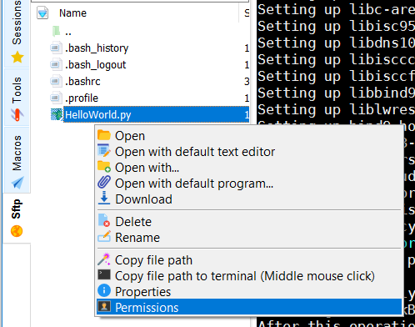
Right-click to the ‘HelloWorld.py’ file and click on Permissions. Then apply execute permission to all.

Slide 11
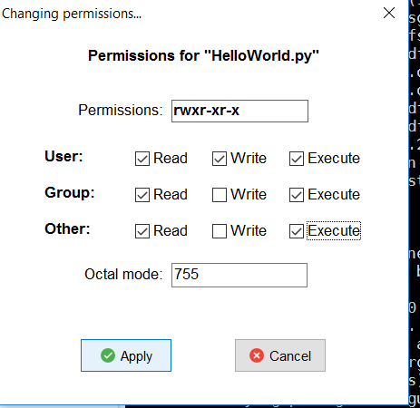
Click apply

Slide 12
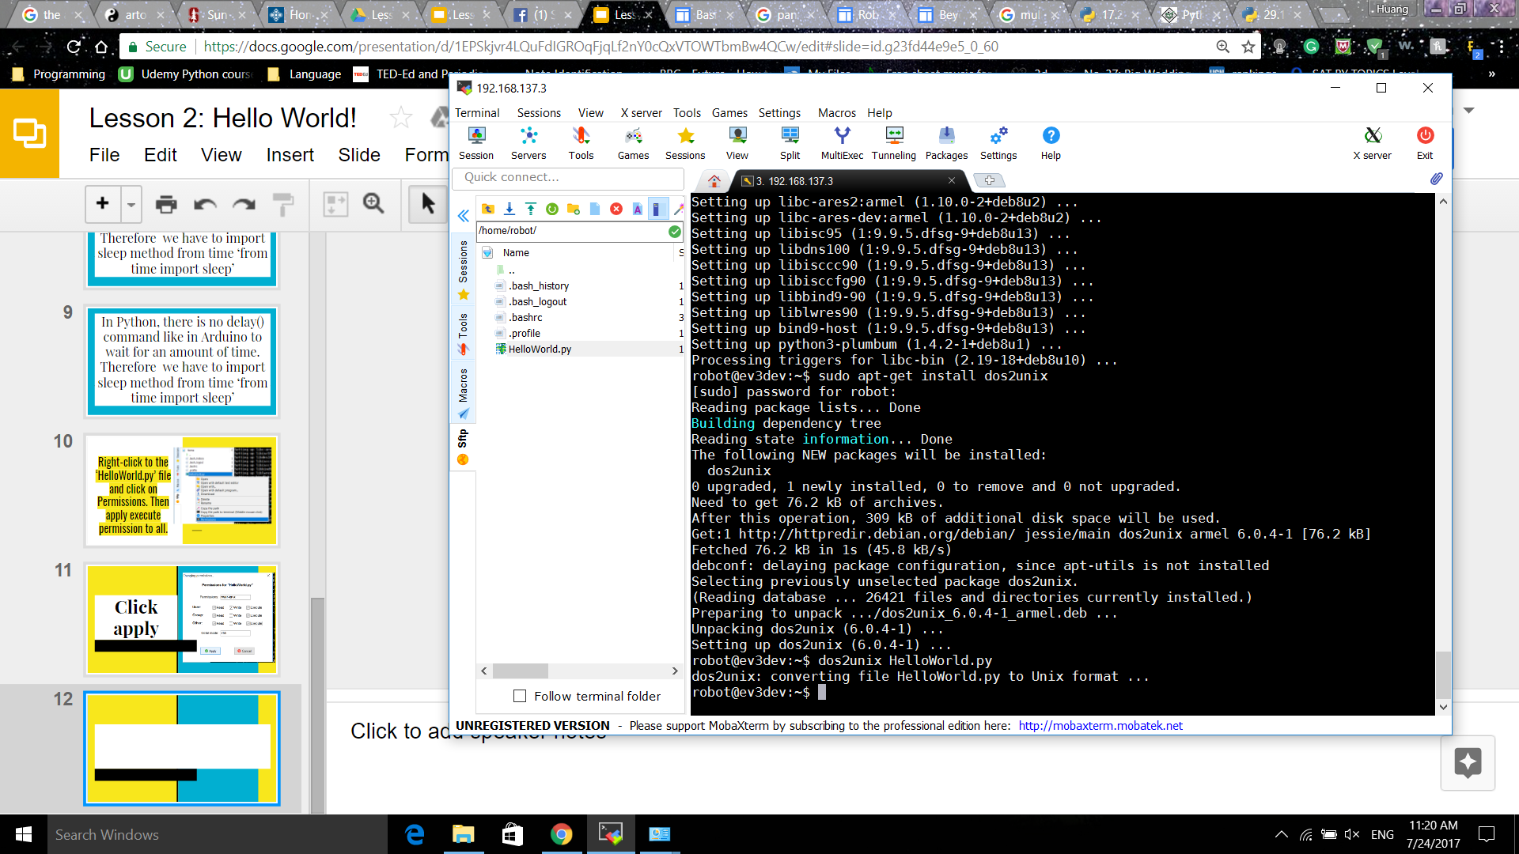
On the command line, type ‘dos2unix HelloWorld.py’ for the program to be executable from the bick

Slide 13
Now you can run the program from the brick. Go to ‘File Browser’ > ‘HelloWorld.py*’
The asterisk * indicates that dos2unix has converted the Windows EOF to Unix EOF.

